Slide 1
BRITISH AIRWAYS
Web scraping to gain company insights

Slide 2
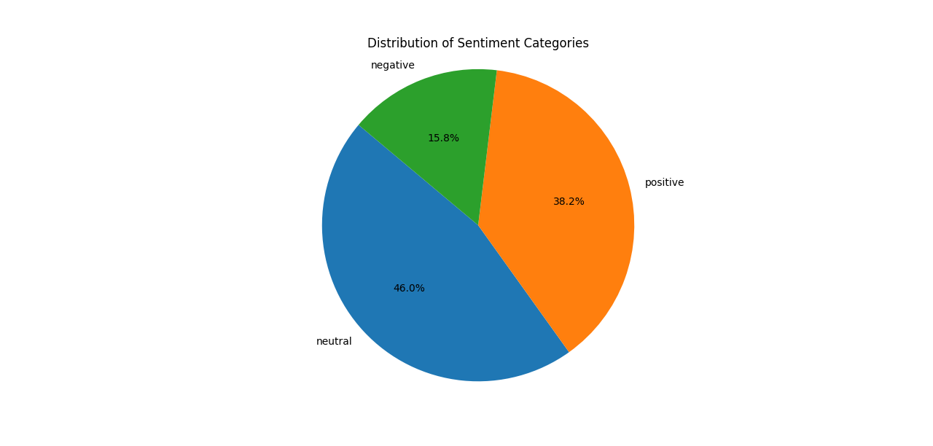
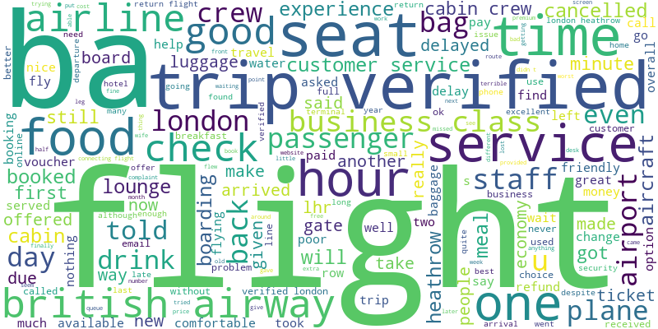
INSIGHTS FROM CUSTOMER REVIEWS
From cleaning 1000 reviews given by the customers, we obtained
Number of Positive Reviews: 382
Number of Negative Reviews: 158
Number of Neutral Reviews: 460
Word cloud of keywords used in reviews

